Slide 1
Session 4: ROS-Industrial Introduction
Shaun Edwards
Sr. Research Engineer
Southwest Research Institute

Slide 2
ROS-Industrial Overview

Slide 3
Overview
Hardware Support
robots, sensors, interfaces
Capabilities
simulation, planning, perception
Applications
dynamic environments, smart control

Slide 4
Hardware Support

Slide 5
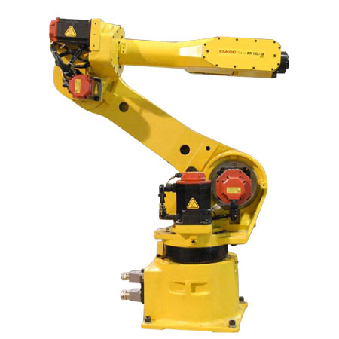
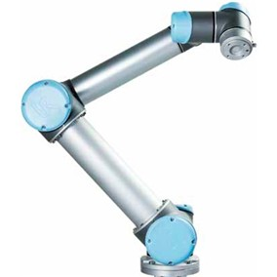
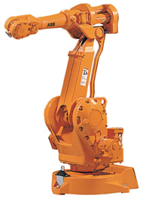
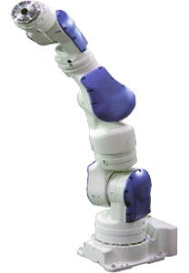
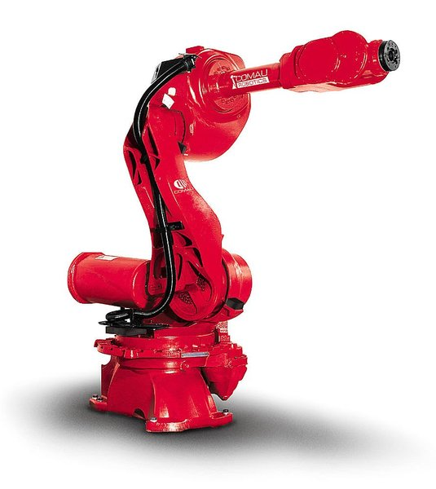
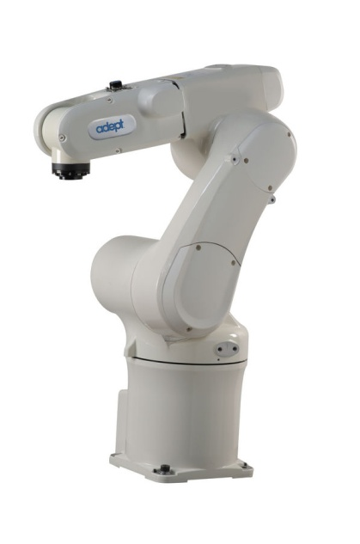
Industrial Robots
Universal Robots
ABB
Fanuc
Comau*
*Coming soon
Motoman
Adept

Slide 6

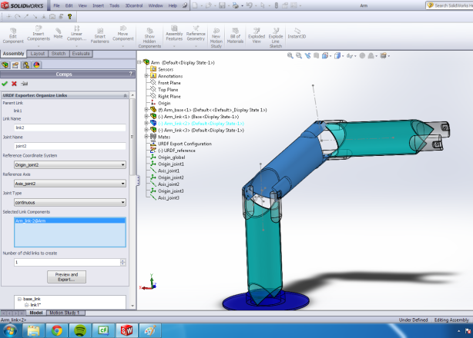
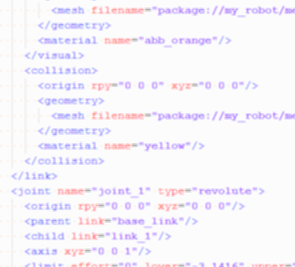
New Robot Support
Easily add support for new robot models
kinematics, STL meshes
wizards: Solidworks, Arm Navigation
config only. No software changes required!

Slide 7



New Robot Support
Easily add support for new robot models
Framework for new robot controllers
robot-side driver/server
ROS client modifications (if needed)
communications
control
feedback
application code
algorithms
user-interface
Robot Driver / Server
motion commands
status monitoring

Slide 8
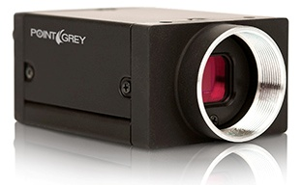
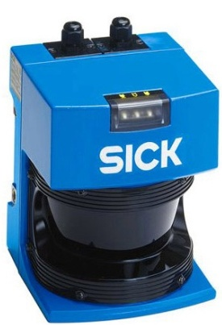
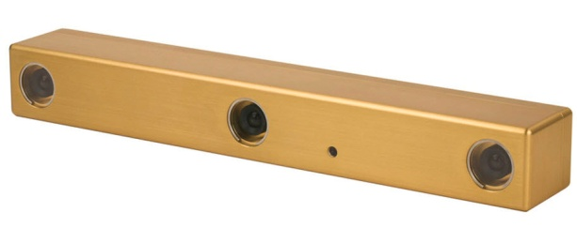
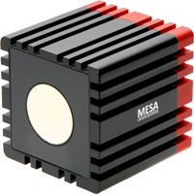
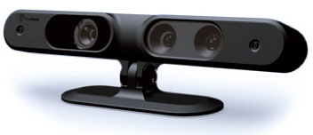
Imaging / Perception Sensors
2D Sensors
cameras (ethernet, firewire)
SICK laser rangefinder
3D Sensors
stereo vision (bumblebee)
kinect (structured light)
swissranger (flash TOF)
And more!

Slide 9
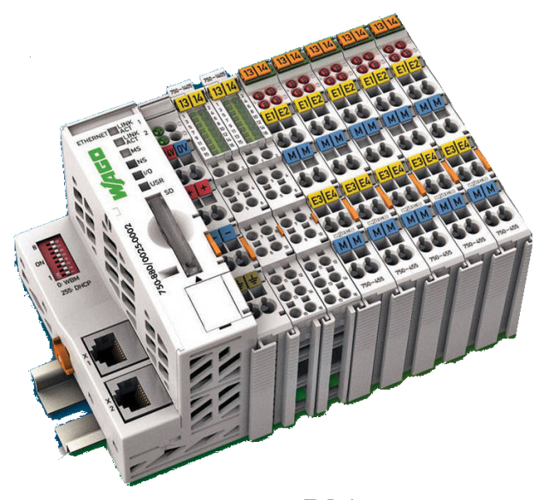
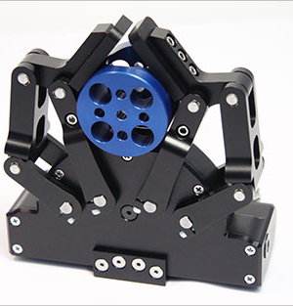
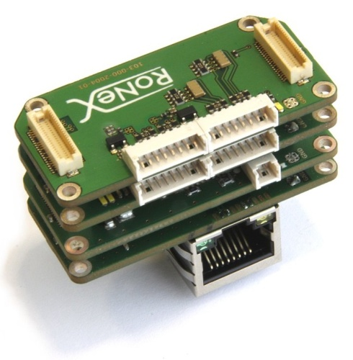
I/O Devices
Somewhat limited...
EtherCAT supported
WAGO modules: DI/O, AI/O, etc.
Robotiq gripper
Ronex
Robot-connected I/O – in progress
Many more: http://wiki.ros.org/Sensors

Slide 10
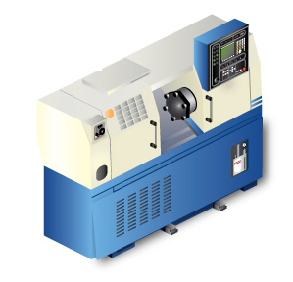

Machine Tool Interface
ROS / MTConnect bridge
communication and data-transfer
synchronize robot tending with CNC operation
MTConnect / ROS
Bridge

Slide 11
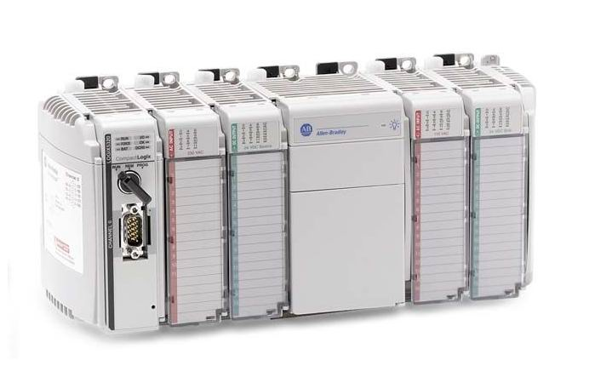



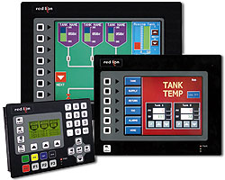

What’s Missing...
PLC Interfaces
Integration of EPICS library planned (http://www.aps.anl.gov/epics/index.php )
Industrial Networks
Ethernet/IP, DeviceNet, Modbus, Profibus, etc.
OPC
Industrial HMIs

Slide 12
Capabilities

Slide 13
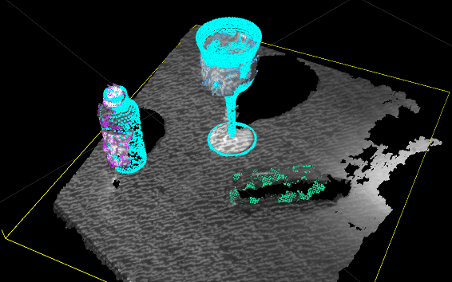
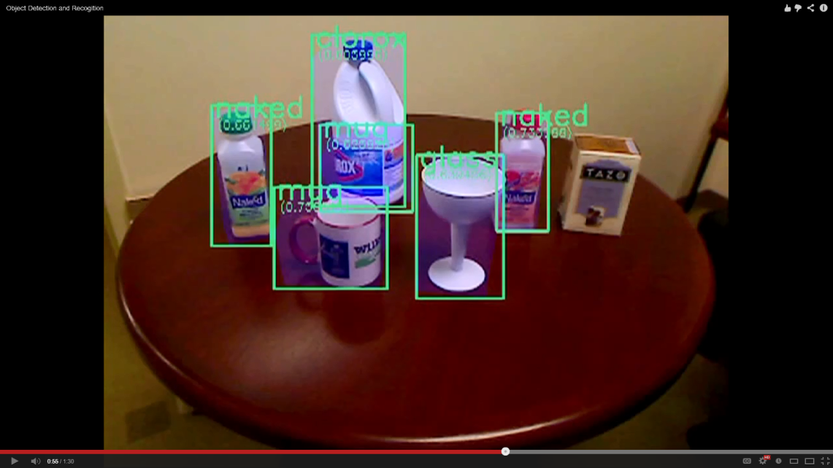
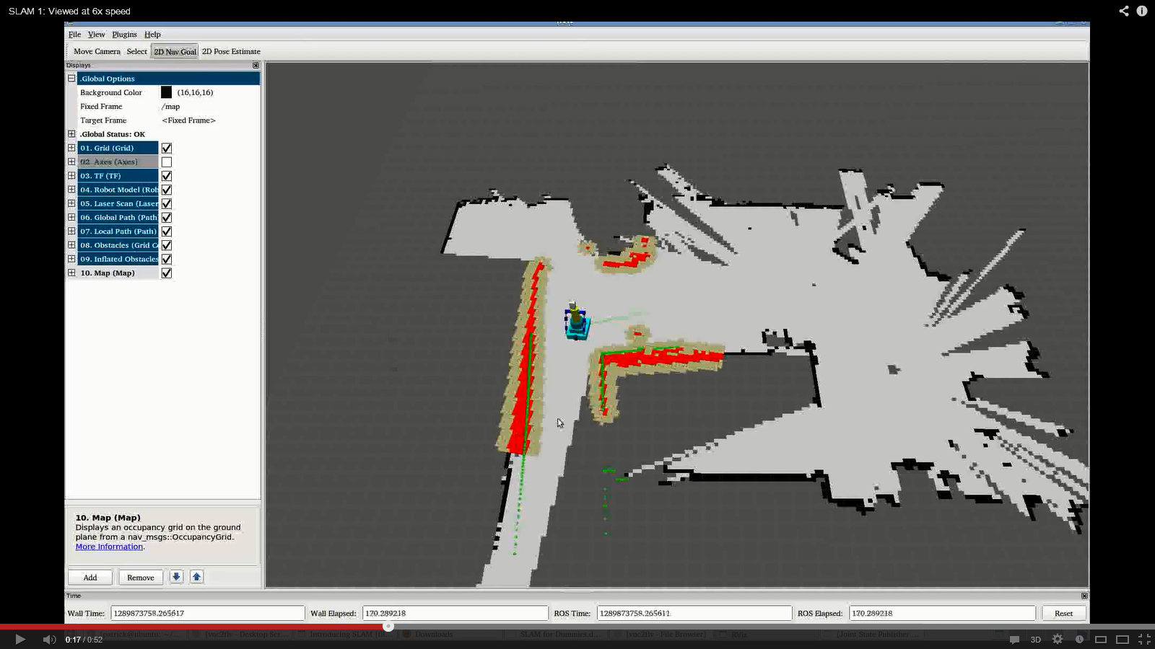
Perception
Segmentation
Identification
Mapping
Notes:
- identify discrete objects on a plane
- filter out “known” objects (robot, environment)
- monitor environment for changes
- compare against DB to classify objects
- build a 2D map on-the-fly from sensor data
- track position in known map using sensor data

Slide 14
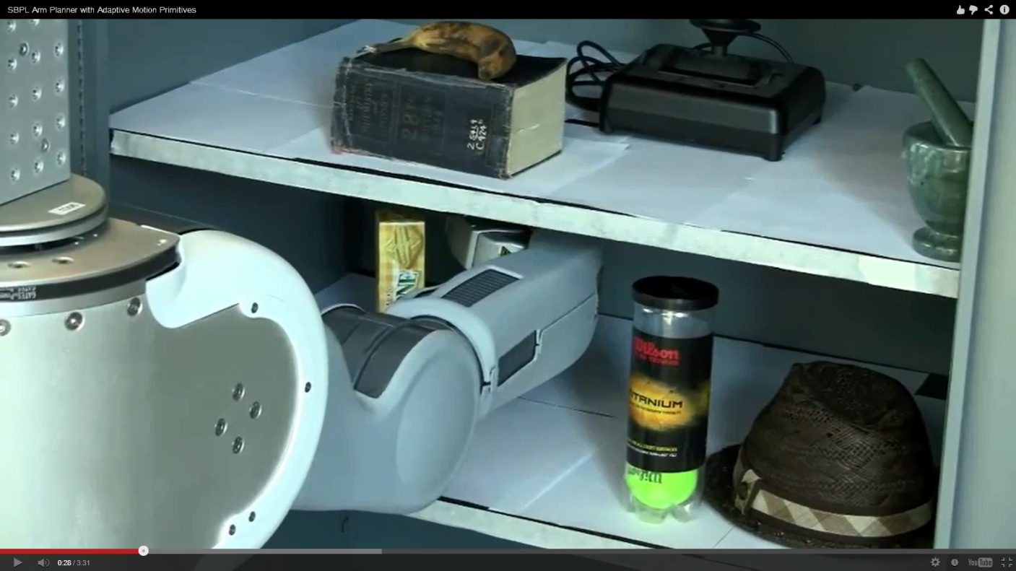

Planning
Collision-aware path planning
automatically finds path to target position
avoids obstacles, joint limits, etc.
On-the-fly checks during execution

Slide 15
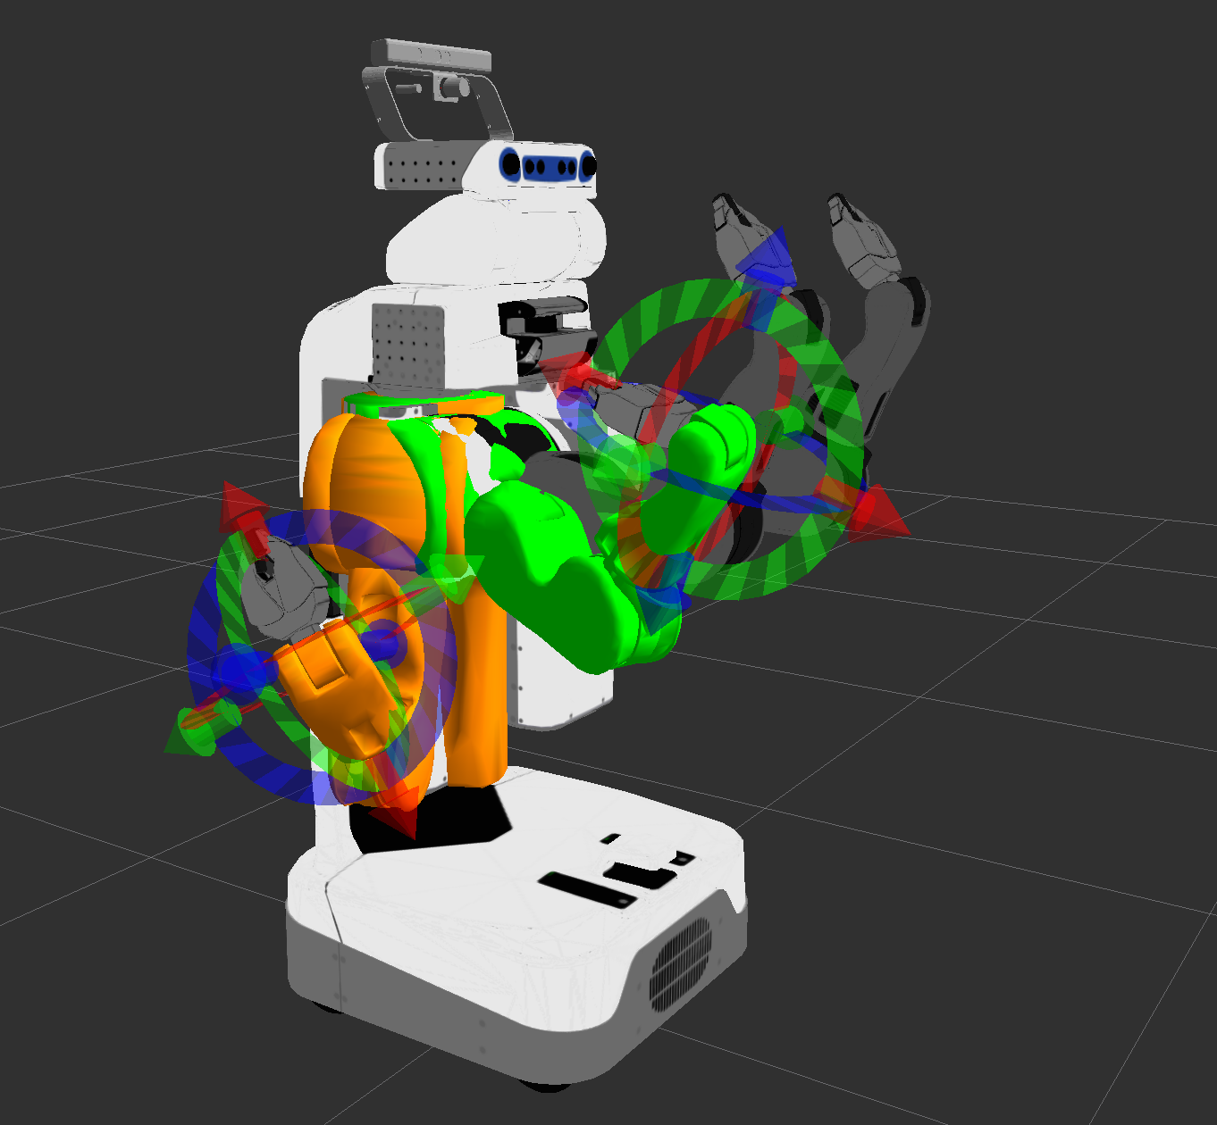
Offline Development
Strong visualization environment
review path-plans, debug control logic
develop application even with no hardware
enables smooth transition to physical system

Slide 16
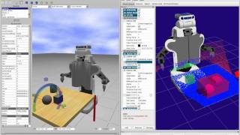
Offline Development
Strong visualization environment
Full physics-based simulation available
includes simulated sensor feedback
Gazebo

Slide 17
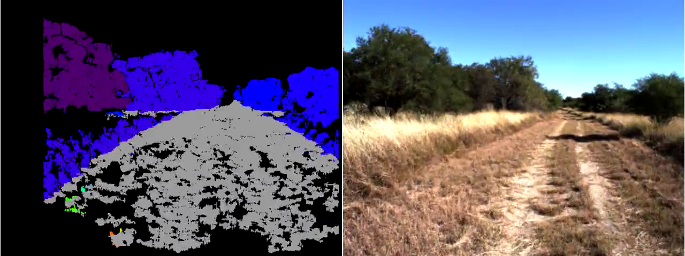
Offline Development
Strong visualization environment
Full physics-based simulation available
Can record and replay data
both sensor and control data
aids development and troubleshooting

Slide 18
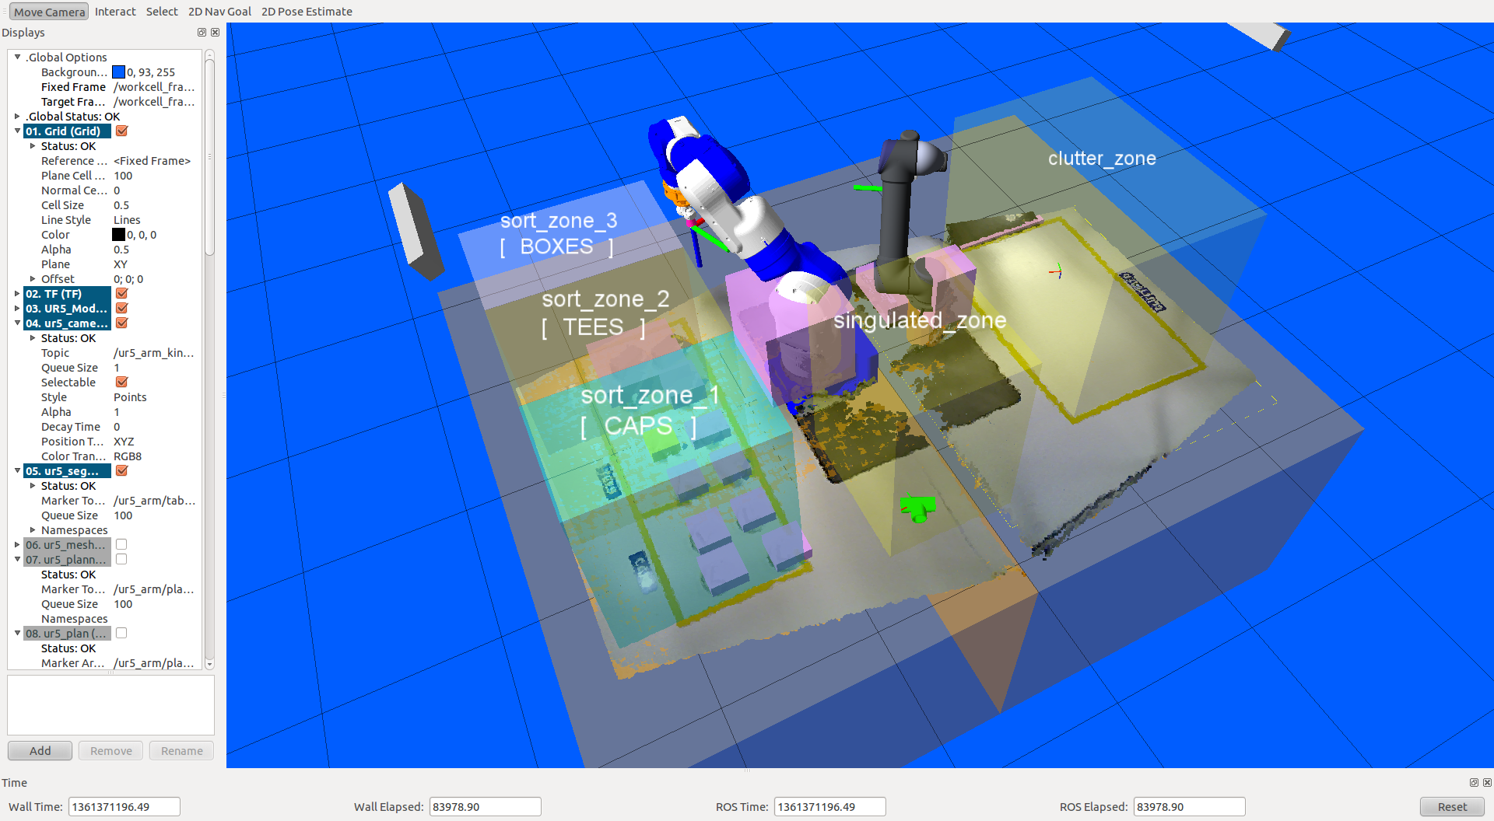
Online Visualization
Update visualization based on live sensor feedback
remote process monitoring
“augmented reality” displays

Slide 19

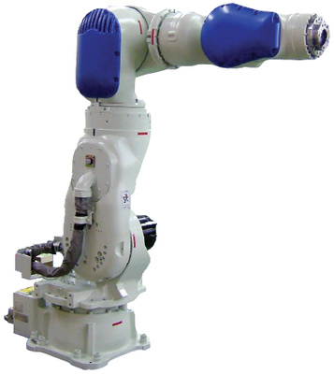
Hardware Independence
Run the same program on different robot platforms.
reduce software “porting” burden
select robot based on capabilities, rather than familiarity

Slide 20
What’s Missing
Precision control of path pos/vel/timing
Simplified programming interface
Motion-related triggers
process control based on path timing
Dynamic path modification
adjust motion based on sensor feedback

Slide 21
Applications

Slide 22
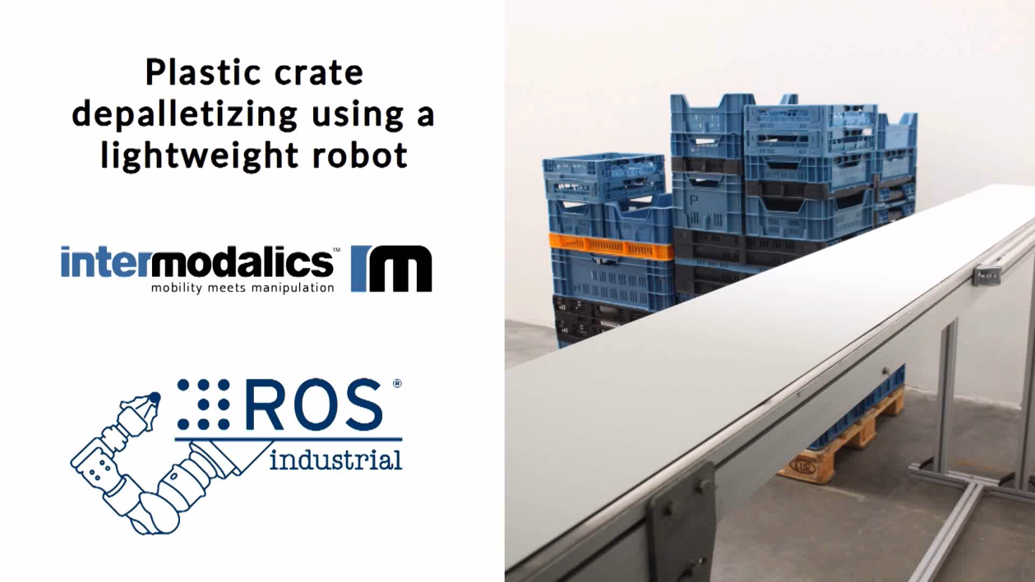
Unknown Part Stream
Technologies
3D scanning
segmentation, filtering
dynamic path planning
large, variable inventory
high-mix, low-lot production

Slide 23
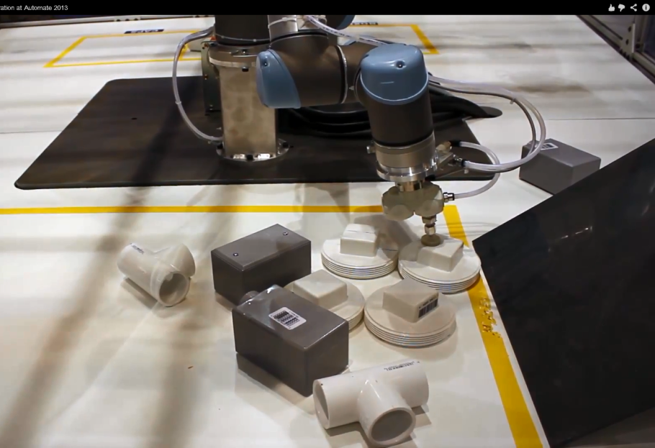
Unstructured Picking
Technologies
3D scanning
segmentation
filtering
path planning
known parts, but random placement
partial occlusions

Slide 24
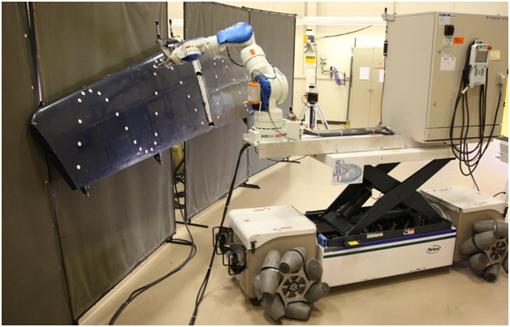
Mobile Robots
Technologies
base / arm support
mapping
localization
path planning
navigation
inventory management
large workspaces

Slide 25
CAD &Plan/Scan & Plan
Technologies
CAD/3D Scanning
Semi-Constrained Path Planning
Visualization
Dynamic Painting, Deburring, Machining
Low Volume/High Mix

Slide 26
General Purpose Calibration
Technologies
2D/3D Processing
Non-linear Optimization
Visualization
Current: Camera to Camera, Camera to Robot calibration
Future: Sensor to X, Robot kinematic calibration

Slide 27
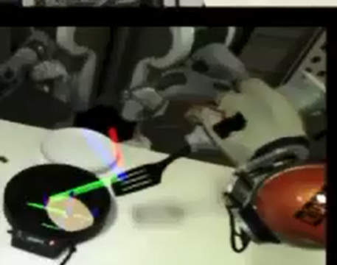
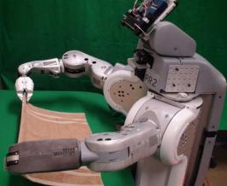
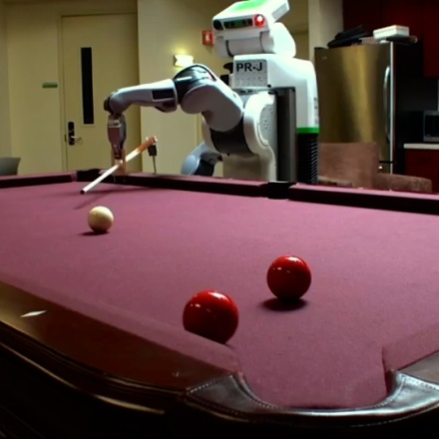
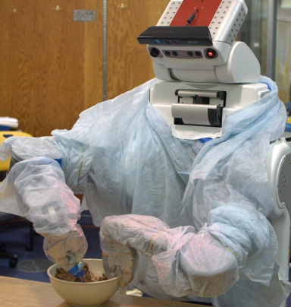
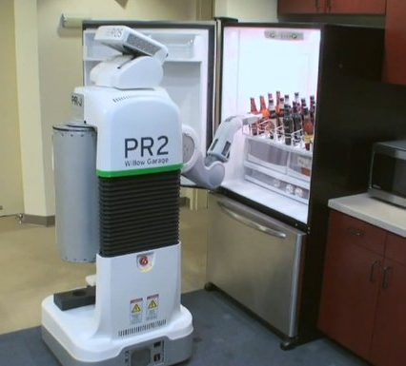
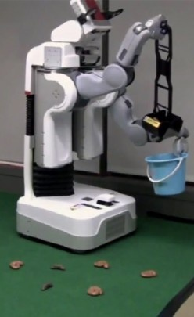
Less-Industrial Applications
cook breakfast
fold laundry
play pool
bake cookies
fetch beer
scoop poop

Slide 28
Summary
Hardware Support
robots: fair, sensors: many, I/O: few
Capabilities
3D perception and planning
Applications
dynamic parts, environment, planning
standard control/monitoring interfaces

Slide 29
Introduction to ROS-I (Users & Developers)

Slide 30
Outline
Community
Wiki Documentation
Getting Help
Installing ROS

Slide 31
Objectives
Learn how to participate and interact in the community
Understanding of ROS/ROS-I wiki
Know where and how to ask for help
Be able to install ROS-I from binary and source
Entertain you ☺

Slide 32
ROS-I is a Community
Members: users, developers, researchers, bystanders, star trek fans(not star wars)
Resources:
Wiki – http://ros.org/wiki/Industrial
Email– http://groups.google.com/group/swri-ros-pkg-dev
Forums – http://answers.ros.org/questions/
Repos – http://github.com/organizations/ros-industrial

Slide 33
ROS-I is a Community
Resources(cont):
Twitter - https://twitter.com/ROSIndustrial
Blog - http://rosindustrial.org/news/
YouTube channel - http://www.youtube.com/channel/UCXyGVRiCwUMc1gav-G7z2ew

Slide 34
ROS-I is a Community
Community is managed, organized, and monitored by SwRI & RIC
Monitored: Wiki, Group emails, Forums
Access Controlled: Repos, Twitter, Blogs, YouTube channel

Slide 35
ROS-I Wiki
A Wiki is a website which allows people to add, modify, or delete the content via a web browser usually using a simplified markup language or a rich-text editor. (http://en.wikipedia.org/wiki/Wiki)
It’s a Wiki, YOU can edit it!

Slide 36
ROS-I Wiki
The ROS/ROS-I wiki contains documentation for users(focus) and developers
Documentation organized according to packages & stacks/meta-packages

Slide 37
ROS-I Wiki
Typical Content
Users
Developers
Overview
Tutorials
Architecture/Design
Code API
Dependencies
Bug Tracker

Slide 38
Wiki Walkthroughs
ROS-I Wiki(follow): http://ros.org/wiki/Industrial
ROS-I Package Wiki (simple_message)(follow): http://ros.org/wiki/simple_message

Slide 39
Getting Help
ROS Answers(follow): http://answers.ros.org/questions/
Developers List: http://groups.google.com/group/swri-ros-pkg-dev
Join here: https://groups.google.com/group/swri-ros-pkg-dev/boxsubscribe

Slide 40

Getting Help
Submitting Bugs (not for any code I have written)
Github Code: http://github.com/organizations/ros-industrial/dashboard/issues
Good bug submission:
Setup, Steps to reproduce, Expected Results
Best bug submission ever:
Good submission + Test Code

Slide 41

Getting Help
Call Us(Consortium Members Only)
Paul Hvass W: 210-522-5823, Home: ….☺
Collaboration
Generally open source
Consulting
Whatever you want
Various IP terms

Slide 42
Installing ROS-I
Binary (using apt-get)
Source (repos)
Recommended for users
Stable
Easy
Required for developers
Github
Harder
Unstable*
Latest capability

Slide 43
Binary Install
Command line: sudo apt-get install <package>
ros-<version>-industrial-core
ros-<version>-industrial-desktop
ros-<version>-abb
ros-<version>-motoman
ros-<version>-fanuc
ros-<version>-adept
ros-<version>-universal-robotics

Slide 44
Source Install
Wiki instructions(follow): http://ros.org/wiki/Industrial/Install

Slide 45
Source Install (Git)
Install latest Hydro Industrial Core(example)
Go to the wiki page for the industrial core stack/metapackage.
Verify the required dependencies are installed on your system (exercise)
Download the hydro version of the package to the current directory
Build the stack

Slide 46
Exercise
Exercise 4.1(follow) - http://aeswiki.datasys.swri.edu/rositraining/hydro/Exercises/4.1

Slide 47
ROS-I - Simple Message Layer (Core Developers)

Slide 48
Outline
Overall Architecture
Simple Message Package Overview
Messages and Connections
Managers and Handlers
Library Linking

Slide 49
Objectives
Understand the top-level ROS-I architecture
Be able to develop ROS-I simple message client/server applications
Understand how the simple message library can be used to bridge ROS messages to simple devices

Slide 50
Top Level Architecture
Notes:
Talk about different layers
Identify ROS-I App & Gui as future
Standard nodes are shown
Configuration data
Availability of ROS ecosystem, move it, and ros gui

Slide 51
Simple Message Detail
Bridge layer between ROS and Robot Controllers

Slide 52
Simple Message Package
Package Overview(follow): http://ros.org/wiki/simple_message
New Typed Messages (Post Groovy)
Joint Trajectory Pt Full (mimics ROS JointTrajectoryPoint) http://ros.org/doc/api/trajectory_msgs/html/msg/JointTrajectoryPoint.html
Robot Status (mimics ROS-I Robot Status) http://ros.org/doc/groovy/api/industrial_msgs/html/msg/RobotStatus.html
Notes:
Motivation
Simple Message
Typed Messages
joint
joint traj pt full
joint traj pt
robot status
Simple Message Connections
TCP Client/Servers
UDP Client/Servers (experimental)

Slide 53
Talker/Listener
Create 2 nodes, talker and listener
Send simple messages between nodes (NOT ROS messages)
Joint Simple
Message (request)
Talker
Listener
Joint Simple
Message (response)

Slide 54
Create an Eclipse Project
Make eclipse project files
Import project into eclipse
Enjoy modern IDE features like code completion, syntax checking, etc…
Do not check project files into repos (they aren’t portable)

Slide 55
Talker Node
// Initialize ROS node "sm_talker"
ros::init(argc, argv, "sm_talker");
// Required to start timers for non-node ROS use.
ros::Time::init();
// Little message to know she's started
ROS_INFO_STREAM("STARTING SM_TALKER");
// Create a TCP client connection to TCP_PORT on LOCAL_HOST (see common.h)
TcpClient client;
client.init(LOCAL_HOST, TCP_PORT);
while(!client.isConnected())
{
ROS_INFO_STREAM("Trying to connect to server");
client.makeConnect();
ros::Duration(0.5).sleep();
}
int seq = 0;
<continued>
while(client.isConnected())
{
// Create a message of type JointMessage and corresponding simple message
JointMessage jmReq;
SimpleMessage req, reply;
seq++;
jmReq.setSequence(seq);
jmReq.toRequest(req);
ROS_INFO_STREAM("Sending sequence number: " << seq);
client.sendAndReceiveMsg(req, reply);
ROS_INFO_STREAM("Received reply code: " << reply.getReplyCode());
ros::Duration(1.0).sleep();
}

Slide 56
Listener Node
// Initialize ROS node "sm_talker" ros::init(argc, argv, "sm_listener"); // Required to start timers for non-node ROS use. ros::Time::init(); // Little message to know she's started ROS_INFO_STREAM("STARTING SM_LISTENER"); // Create a TCP server connection on TCP_PORT (see common.h) TcpServer server; server.init(TCP_PORT); while(!server.isConnected()) { ROS_INFO_STREAM("Trying to connect to client"); server.makeConnect(); ros::Duration(0.5).sleep(); } while(server.isConnected()) { // Create a message of type JointMessage JointMessage jmReq, jmReply; SimpleMessage req, reply; ROS_INFO_STREAM("Waiting for client request"); server.receiveMsg(req);
if( req.getMessageType() == jmReq.getMessageType() ) { if( req.getCommType() == CommTypes::SERVICE_REQUEST ) { jmReq.init(req); ROS_INFO_STREAM("Received sequence number: " << jmReq.getSequence()); jmReply.toReply(reply, ReplyTypes::SUCCESS); server.sendMsg(reply); ROS_INFO_STREAM("Sending reply code: " << reply.getReplyCode()); } else { ROS_ERROR_STREAM("Unexpected comm type: " << req.getCommType()); } } else { ROS_ERROR_STREAM("Unexpected message type: " << req.getMessageType()); } }

Slide 57
Exercise
Exercise 4.2(Part 1) - http://aeswiki.datasys.swri.edu/rositraining/hydro/Exercises/4.2

Slide 58
Message Manager/Handler
Message manager/handlers simplify relaying simple messages (similar to ROS msg callbacks)
Allows multiple data streams to use the same connection

Slide 59
Library Linking
Simple Message compiled as a library for inclusion in other packages
2 versions compiled (normal, byte swapped)
Linking to Simple Message library (non-standard)
Example: http://ros.org/wiki/simple_message#Library_Linking

Slide 60
Message Handler
// Handler class defined specifically for this example class MyHandler : public MessageHandler { // since this class defines a different init(), this helps find the base-class init() using MessageHandler::init; public: bool init(SmplMsgConnection* connection) { return this->init(StandardMsgTypes::JOINT, connection); } private: bool internalCB(industrial::simple_message::SimpleMessage & in) { bool rtn = false; JointMessage jm; SimpleMessage msg; if (jm.init(in)) { ROS_INFO_STREAM("Received sequence number: " << jm.getSequence());
if (jm.toReply(msg, ReplyTypes::SUCCESS)) { if (this->getConnection()->sendMsg(msg)) { ROS_INFO_STREAM("Sending reply code: " << msg.getReplyCode()); rtn = true; } else { ROS_ERROR("Failed to send joint message return"); rtn = false; } } else { ROS_ERROR("Failed to generate joint reply message"); rtn = false; } } else { ROS_ERROR("Failed to initialize joint message"); rtn = false; } return rtn; } };

Slide 61
Manager
// Initialize ROS node "sm_talker" ros::init(argc, argv, "sm_listener"); // Required to start timers for non-node ROS use. ros::Time::init(); // Little message to know she's started ROS_INFO_STREAM("STARTING SM_MANAGER");
TcpServer server; server.init(TCP_PORT); MessageManager manager; MyHandler handler; manager.init(&server); handler.init(&server); manager.add(&handler); manager.spin();

Slide 62
Exercise
Exercise 4.2(Part 2) - http://aeswiki.datasys.swri.edu/rositraining/hydro/Exercises/4.2

Slide 63
ROS-I - Interface Layer (Core Developers)

Slide 64
Outline
Industrial Robot Driver Specification
Industrial Messages
Industrial Robot Clients
Industrial Robot Simulator
Joint Trajectory Filters

Slide 65
Objectives
Understand the motivation and function of the ROS-Industrial Driver Specification
Understand how to use of the industrial robot clients as standard nodes for talking to robot controllers
Understand how to use the industrial robot simulator
Awareness of the joint trajectory filter package

Slide 66
Simple Detail
Bridge layer between simple message and high level software

Slide 67
ROS-Industrial Specification
ROS-I Wiki(follow): http://ros.org/wiki/Industrial/Industrial_Robot_Driver_Spec
Notes:
Motivation
Minimal
Full
Hardware Compatibility
Future

Slide 68
Industrial Messages
ROS-I Wiki(follow): http://ros.org/wiki/industrial_msgs
Notes:
Robot status
Motion command service
JointTrajectory
JointStates

Slide 69
Industrial Robot Clients
ROS-I Wiki: http://ros.org/wiki/industrial_robot_client
3 Types of nodes
Motion (command joint motion)
Streaming & download
State (joint positions and status)
Joint Trajectory Action (Follow joint trajectory action server)
Action
Node
State
Node
Motion
Node
Notes:
Client nodes adhere to the ROS-I spec

Slide 70
Industrial Robot Simulator
Different from MoveIt Simulator
ROS-I Wiki: http://ros.org/wiki/industrial_robot_simulator
Simulates both robot motion and state nodes (i.e. adheres to spec)
Allows quick development without hardware
Action
Node
Sim
Node

Slide 71
Joint Trajectory Filters
Experimental (Post Groovy)
Every moveit/arm navigation package has a joint_limits.yaml. See: http://ros.org/wiki/trajectory_filters
ROS-I Wiki (follow): http://ros.org/wiki/industrial_trajectory_filters
Very useful for smoothing out and improving joint motion.

Slide 72
Introduction to Using ROS-I (app Developers)

Slide 73
Outline
Top Level Architecture
Application Layer
GUI Layer
Common Application Tasks

Slide 74
Objectives
Understand the various ways to create application level programs
Understand the interface layer(s)
Understand the possibilities
Steps to build up to an application

Slide 75
Top Level Architecture
Notes:
Application layer
Joint Trajectory action interface/ROS-I spec interface

Slide 76
Application Layer
ROS Layer
Anything you can imagine
MoveIt Layer
Planning
Kinematics
Pick & Place
Workspace evaluation
ROS-I Layer (Future)
Process based planner
Industrial state machines

Slide 77
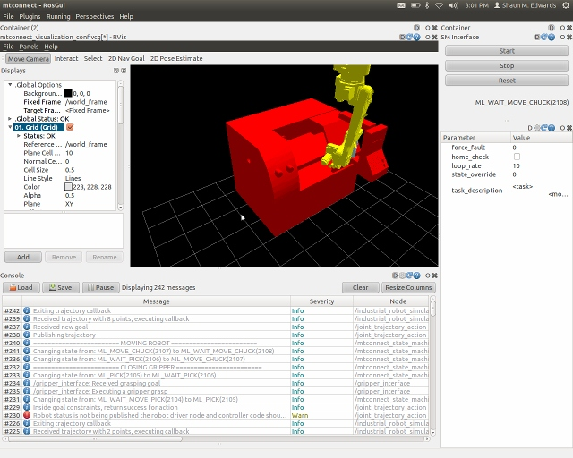
GUI Layer
ROS GUI
Qt based GUI
Powerful
Widget based
Cross platform (although ROS isn’t)
ROS-I GUI (Future)
Generic pendant
Standard industrial UI
Industrial Widgets

Slide 78
Applications Building
Create MoveIt configuration for your application
Verify configuration with physical robot cell (exercise 4.3)
Tweak motion to meet your needs (exercise 4.4)
Build your application code (application specific)
Build GUI interface (application specific)

Slide 79
Machine Tending Application
Robot, CNC, & Caging
Verify robot and physical layout
Fast motion for large moves, fine motion for interfacing with external equipment
Create industry standard state machine (start, stop, fault reset interface)
Create GUI that has buttons for changing modes, error logs, visualization.

Slide 80
Robot Package Verification
Exercise 4.3 http://aeswiki.datasys.swri.edu/rositraining/hydro/Exercises/4.3

Slide 81
Improving Robot Motion
Exercise 4.4 http://aeswiki.datasys.swri.edu/rositraining/hydro/Exercises/4.4

Slide 82
Future ROS-I Development

Slide 83
Outline
What the Future Holds
Please Share Your Ideas

Slide 84
Objectives
Tell you where we are going
Ask you where you want us to go

Slide 85
What's next?
Flexible robot IO control
Improved drivers (vendor supported)
Improved calibration support (single pass robot cell calibration)
Generalized process-aware Cartesian path planners

Slide 86
Standard GUI

Slide 87
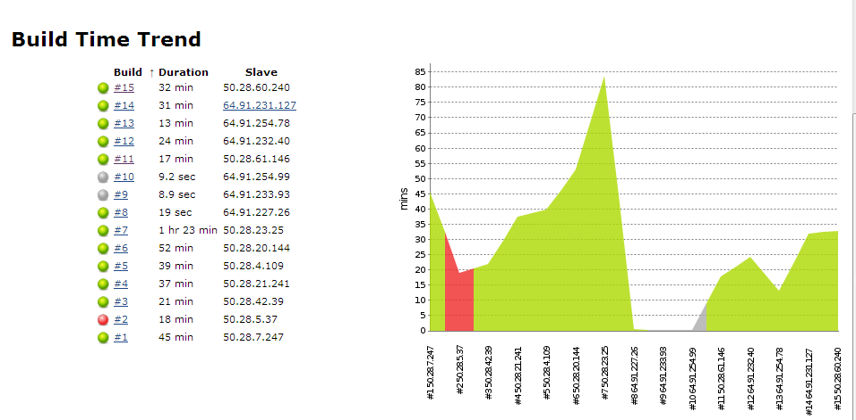
Code Metrics/Unit Tests
Jenkins continuous integration

Slide 88
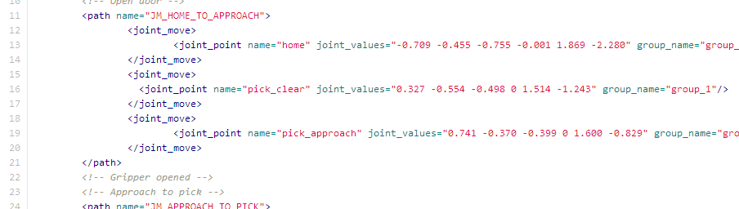
Robot Task Description Format
XML file format for describing arbitrary motion
Expressive enough for high/low density waypoints
Encapsulates process data

Slide 89
Roadmap
ROS-I Wiki (follow): http://ros.org/wiki/Industrial/Roadmap

Slide 90

What do YOU want?

Slide 91
Introduction to Perception

Slide 92
Outline
Kinect Introduction
TF & Camera Calibration
Exercise 4.5
Explanation of the Perception Tools Available in ROS
Detailed review of PCL tools
Exercise 4.6

Slide 93
Objectives
Understanding of the perception tools
Experience with Kinect data and RVIZ
Experience with Point Cloud Library tools

Slide 94

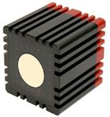
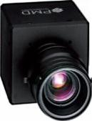
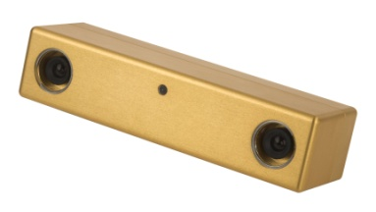
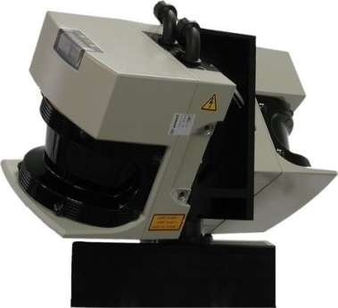
3D Cameras
RGBD cameras, TOF cameras, stereo vision, 3D laser scanner
Produce (colored) point cloud data
2.5D data (view point)
Huge data volume
Over 300,000 points per cloud
30 Hz frame rate
Driver for Asus Xtion camera is in the package openni_launch
Driver for AVT/Prosilica Gigabit Ethernet (GigE) cameras is in the package prosilica_camera

Slide 95
TF: Overview
TF used to track all coordinate frames in ROS
Each frame is related to at least one other frame
TF can be used to find transforms between any two relatable frames, even in the past!
TF designed as a distributed network
“A,B”
Transform Between A/E?
“D,E”
Frame C
Frame E
“B,C,D”
Frame A
Frame B
Frame D

Slide 96
TF: c++
A transformListener listens to all tf messages and tries to determine relative transforms
Can try to transform in the past
Can only look as far back as it has been running
ros::init(argc, argv, "tf_listener");
ros::NodeHandle nh;
tf::TransformListener listener;
tf::StampedTransform transform;
listener.lookupTransform(“target”, “source”, ros::Time(), transform);

Slide 97
TF: c++
Each robot_state_publisher publishes transforms for a particular urdf
Nodes can also publish /tf data
DANGER! TF data can be conflicting
<launch>
<param name="robot_description" textfile="$(find motoman_config)/cfg/sia5.xml" />
<node name="state_publisher" pkg="robot_state_publisher" type=“robot_state_publisher" />
<node name="joint_state_publisher" pkg="joint_state_publisher" type="joint_state_publisher" />
</launch>
“D,E”
“A,B”
Transform Between A/E?
Frame C
Frame E
“B,C,D”
Frame A
Frame D
Frame B

Slide 98
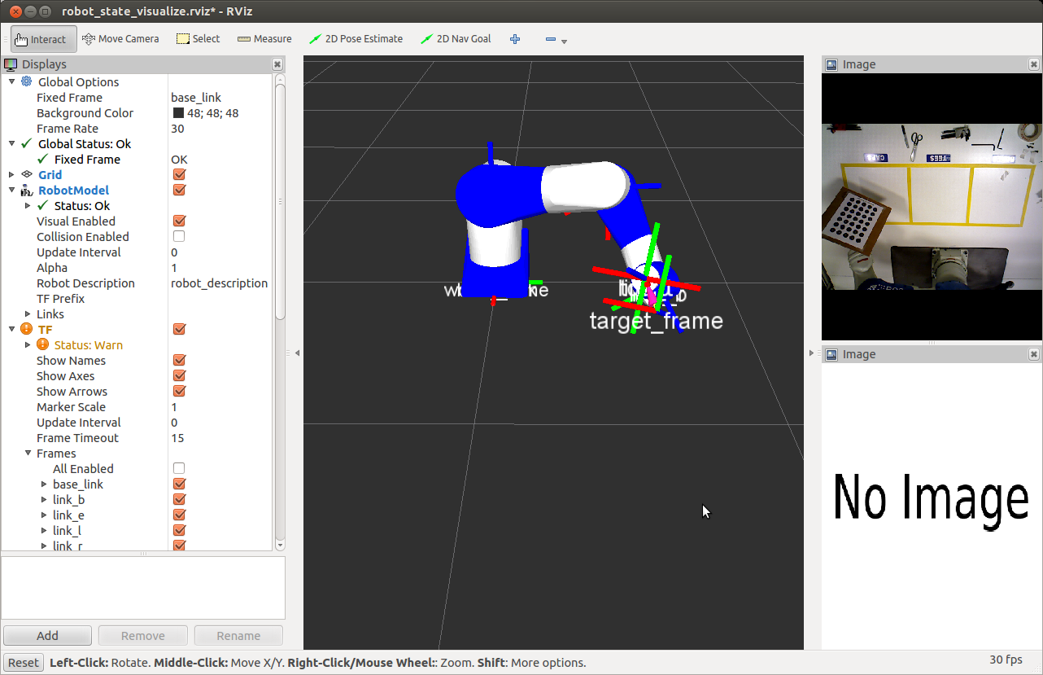
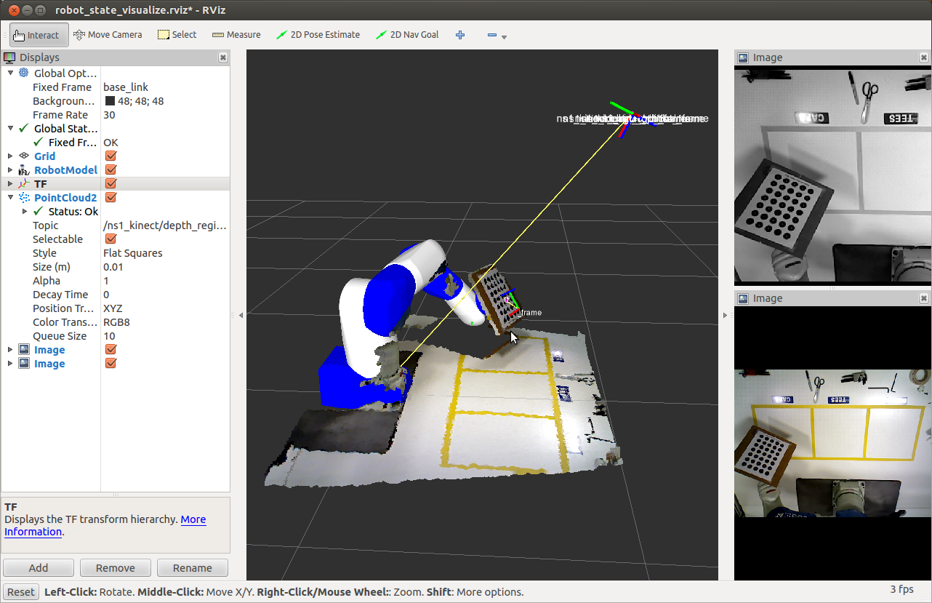
TF – Camera Calibration

Slide 99

Extrinsic Camera Calibration
Calibration package wiki
Calibration tutorial
Calibration source code

Slide 100
Exercise
Exercise 4.5 - https://aeswiki.datasys.swri.edu/rositraining/hydro/Exercises/4.5

Slide 101

Example: Pick & Place

Slide 102
Perception Processing Pipeline
Goal: Gain knowledge from sensor data
Process data in order to
Improve data quality  filter noise
Enhance succeeding processing steps  reduce amount of data
Create a consistent environment model  Combine data from different view points
Simplify detection problem  segment interesting regions
Gain knowledge about environment  classify surfaces
3D Camera
Processing
Robot Capabilities

Slide 103
Perception Tools
Overview of PCL
Overview of OpenCV
PCL and OpenCV in ROS
Other libraries
Focus on PCL tools for exercise

Slide 104
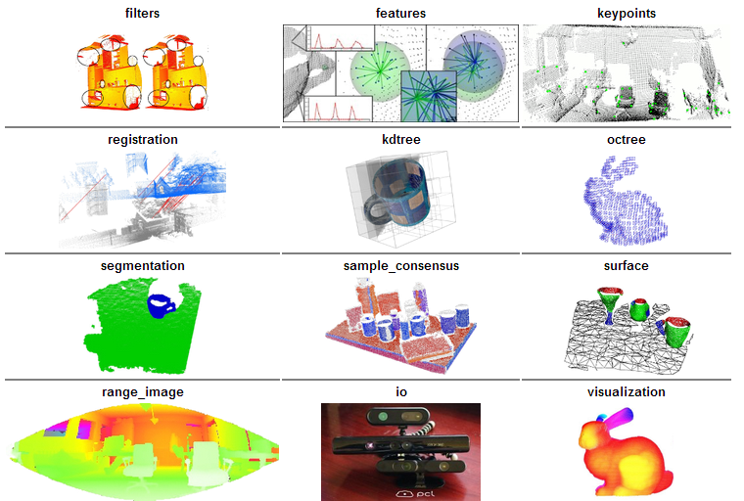
Perception Libraries
Point Cloud Library (PCL) - http://pointclouds.org/
Focused on 3D Range(Colorized) data
http://pointclouds.org

Slide 105
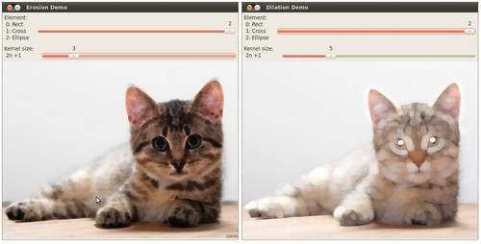
Perception Libraries
Open Computer Vision Library (OpenCv) - http://opencv.org/
Focused on 2D images
2D Image processing
Video
Sensor calibration
2D features
GUI
GPU acceleration
http://opencv.org

Slide 106
ROS Bridges
OpenCV & PCL are external libraries
“Bridges” are created to adapt the libraries to the ROS architecture
OpenCV: http://ros.org/wiki/vision_opencv
PCL: http://ros.org/wiki/pcl_ros
Standard Nodes: http://ros.org/wiki/pcl_ros#ROS_nodelets

Slide 107
Many More Libraries
Many more libraries in the ROS Ecosystem
AR Tracker - http://www.ros.org/wiki/ar_track_alvar
Object Recognition - http://www.ros.org/wiki/object_recognition
Robot Self Filter - http://www.ros.org/wiki/robot_self_filter
Let me Google that for you ☺ - http://lmgtfy.com/

Slide 108
Perception Pipeline
Perception Process
Overall Process
Obtain PointCloud
PCL Methods
3D Camera
Voxel Grid
Convert PointCloud
ROS->PCL
Filter PointCloud
PassThrough
Processing
Convert PointCloud
PCL->ROS
RANSAC Plane
Segmentation
Publish PointCloud
Robot Capabilities
Others...
Broadcast Transform*

Slide 109
Voxel Grid
Creates a 3D voxel grid over the input point cloud data
In each voxel (i.e., 3D box), all the points present will be approximated (i.e., downsampled) with their centroid
http://pointclouds.org/documentation/tutorials/voxel_grid.php#voxelgrid

Slide 110
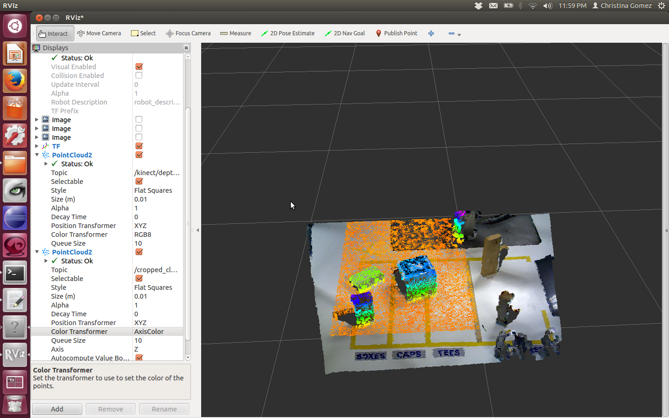
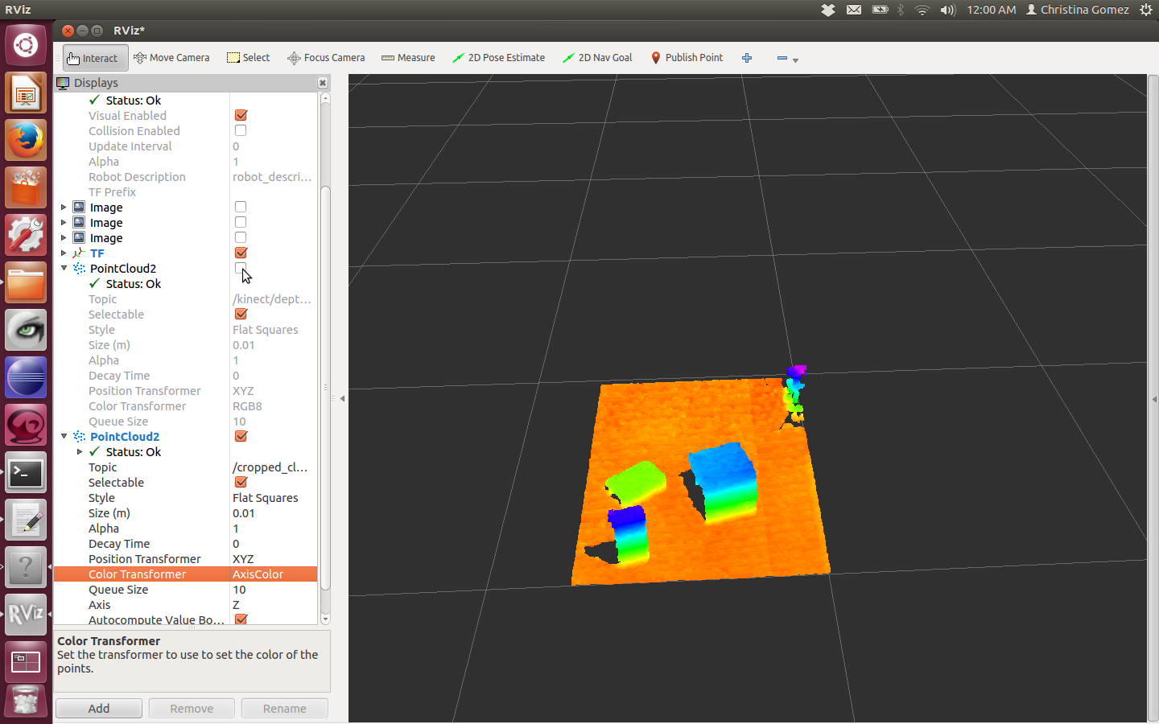
PassThrough
Cut off values that are either inside or outside a given user range
http://pointclouds.org/documentation/tutorials/passthrough.php#passthrough

Slide 111

Plane Segmentation - RANSAC
“RANdom SAmple Consensus” (RANSAC), and it is an iterative method that is used to estimate parameters of a mathematical model from a set of data containing outliers
http://pointclouds.org/documentation/tutorials/random_sample_consensus.php#random-sample-consensus
Plane model: ax+by+cz+d=0

Slide 112
Plane Seg. – Extract Indices
Find all the points within a point cloud that support a plane model http://pointclouds.org/documentation/tutorials/planar_segmentation.php#planar-segmentation

Slide 113

Other – Clusters
Euclidean Cluster Extraction - A clustering method needs to divide an unorganized point cloud model into smaller parts
http://pointclouds.org/documentation/tutorials/cluster_extraction.php#cluster-extraction
http://plasmodic.github.io/ecto_pcl/examples/colorize_clusters.html

Slide 114

Other – SOR
Statistical Outlier Removal - Remove noisy measurements, e.g. outliers, from a point cloud dataset using statistical analysis techniques
http://pointclouds.org/documentation/tutorials/statistical_outlier.php#statistical-outlier-removal

Slide 115
Other
CropBox
Segmentation - Region Growing, Min-Cut Based, Cylinder Model
Clustering - Conditional Euclidean
Even more:
Features
Recognition
Registration…
http://pointclouds.org/documentation/

Slide 116
Exercise
Exercise 4.6 - https://aeswiki.datasys.swri.edu/rositraining/hydro/Exercises/4.6

Slide 117

Contact Information
Christina Gomez
Research Engineer
Southwest Research Institute
6220 Culebra Rd.
San Antonio, TX 78251 USA
Phone: 210-522-3536 Email: cgomez@swri.org
Robotics.swri.org

Slide 118

Contact Information
Shaun Edwards Senior Research Engineer
Southwest Research Institute
6220 Culebra Rd.
San Antonio, TX 78251 US
Phone: 210-522-3277 Email: sedwards@swri.org
www.rosindustrial.org
www.ros.org/wiki/Industrial

